Slide 1
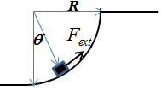
Homework 6 (Chap 7-8)
1. An external force, parallel to the displacement, is pushing a small particle of mass m in the very slow motion from the bottom to the top of the quarter circle of radius R, shown in Fig. 1. The frictional coefficients of the circle surface is . Calculate the work done by the external force. Useful information:
Fig. 1
2. A particle is confined to move along the x-axis with the following potential energy,
where x is the coordinate of the particle in unit of μm, and U(x) are in units of electron volts (eV).
Determine the force F experienced by the particle as a function of x.
At what values of x is F(x) equal to zero?
Indicate the positions of the stable and the unstable equilibrium of the particle at the potential energy at these positions.
If the total energy of the particle at the stable equilibrium position is 4eV, determine the range of the motion of this particle.

Slide 2
3. Problem 8-85 in Giancoli (pp. 211)
A ball is attached to a horizontal cord of length whose other end is fixed, Fig. 8–42.
If the ball is released, what will be its speed at the lowest point of its path?
A peg is located a distance h directly below the point of attachment of the cord. If h = 0.8ℓ what will be the speed of the ball when it reaches the top of its circular path about the peg?

Slide 3
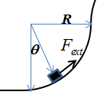
1. (10 pts) A external force is pushing a small particle of mass m in the very slow motion from the bottom of the quarter circle of radius R, to the top. Due to snow yestoday, the frictional coefficients of the circle surface is .
Calculate the work done by the external force.
2
y
N
3
x
f_{k}
mg
1
1
1
2

Slide 4
2. A particle is confined to move along the x-axis with the following potential energy,
where x is the coordinate of the particle in unit of μm, and U(x) are in units of electron volts (eV).
Determine the force F experienced by the particle as a function of x.
At what values of x is F(x) equal to zero?
Indicate the positions of the stable and the unstable equilibrium of the particle at the potential energy at these positions.
If the kinetic energy of the particle at the stable equilibrium position is 6eV, determine the range of the motion of this particle.
(a)
Total Energy
(b)
(c)
Therefore, U(x) has a stable equilibrium at x = 1μm.
Therefore, U(x) has a unstable equilibrium at x = -1μm.

Slide 5
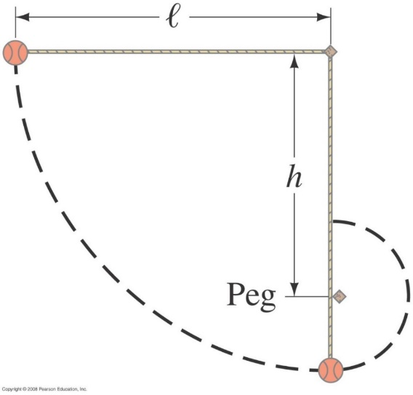
3. Problem 8-85 in Giancoli (pp. 211)
A ball is attached to a horizontal cord of length whose other end is fixed, Fig. 8–42.
If the ball is released, what will be its speed at the lowest point of its path?
A peg is located a distance h directly below the point of attachment of the cord. If h = 0.8ℓ what will be the speed of the ball when it reaches the top of its circular path about the peg?
(a)
(1)
(3)
(b)
(2)

